Slide 1
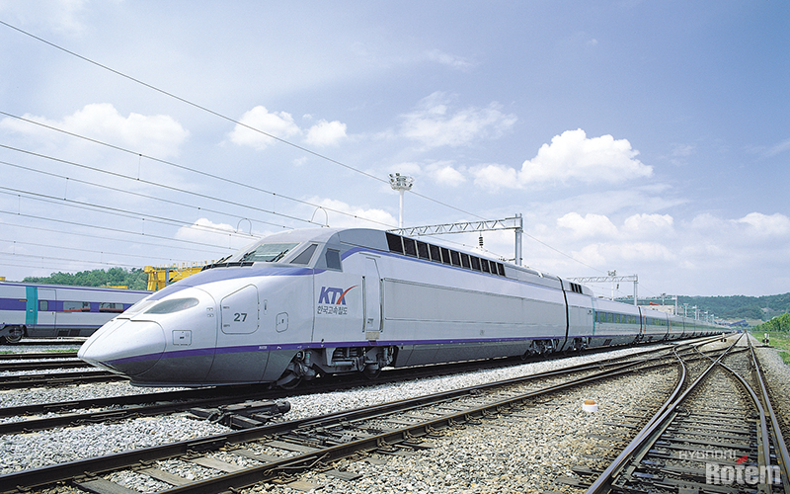



Diagnosis & Condition
SEHWA
1% POSSIBILITY…REALIZE
CONCEPT and Flow
Jimin Ha
jmha@sehwa.biz

Slide 2

Table Definition
* 모든 데이터는 계룡 데이터 기준임
요구사항 | DIVISION | CONTENTS |  |  |  |  |  |  |  | etc.
CONDITION | 기술통계 Descriptive Statistics | 평균 | 최대 |  | 최소 |  | 편차 |  | 분산 | 모집단의 특성 규명
 | 비율 Percentage Diagnosis | 기술지원시스템 상태 개수 |  |  |  |  |  |  |  | 주의, 경고, 조치 count or 자체 진단 count
STATE DIAGNOSIS | 절대값 진단 | 절대값에 따른 전압 변화
 | 비율 진단 | 주의, 경고, 조치 값에 해당하는 변화 퍼센트 |  |  |  |  |  |  |  | 설비 기준값 기준
 | 변화 | 평균값 변화 |  | 잦은 변화 |  |  |  | 일시 변화 |  | 평균의 변화지점 (Rupture)-출렁이는 구간
 | 빈도 분석 | 순간 알람 |  |  |  | 군집 알람
 | 상관 관계 | 같은 조건 장치 필터
 | TLDS 상태 진단 | 점유시 검측값 비감소
 |  | 상태 count
 |  | 주파수 기준값
 |  | 비점유시 이상 검측값
 | 상태전이 다이어그램 | FSM 적용 |  |  |  |  |  |  |  | 유한 상태 알고리즘
ABOUT IDEA | 장애 카테고리 | 장애 원인별 카테고리 그래프
 | 이동 평균변화 | 이동평균 그래프 추이 변화

Slide 3
Table Definition
-Duplicate Except
* 모든 데이터는 계룡 데이터 기준임
 | DIVISION | CONTENTS |  |  |  |  |  |  |  | etc.
CONDITION | 기술통계 Descriptive Statistics | 평균 | 최대 |  | 최소 |  | 편차 |  | 분산 | 절대값 진단 | 전체 필터링
 | 비율 Percentage Diagnosis | 기술지원시스템 상태 개수 |  |  |  |  |  |  |  | 비율 진단
STATE DIAGNOSIS | 변화 Change Detection | 평균값 변화 |  | 잦은 변화 |  |  |  | 일시 변화 |  | 평균의 변화지점 (Rupture) -출렁이는 구간…
 | 빈도 분석 | 순간 알람 |  |  |  | 군집 알람
 | TLDS 상태 진단 TLDS STATE DIAGNOSIS | 점유시 검측값 비감소
 |  | 주파수 기준치 이상
 |  | 비점유시 기준치 이상
 |  | 비율 진단
 | 상태전이 다이어그램 FINIT STATE MACHINE | FSM 적용 |  |  |  |  |  |  |  | 유한 상태 알고리즘
ABOUT IDEA | 장애 카테고리 INCIDENT CATEGORY | 장애 원인별 카테고리 그래프
 | 이동 평균 MOVING AVERAGE | 이동평균 그래프 추이 변화

Slide 4
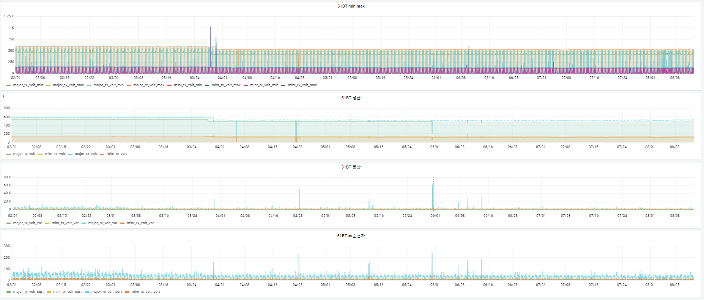
Descriptive Statistics Total

Slide 5
Descriptive Statistics
-Average
Average : 데이터의 중심값
20mV , 40mV 평균값의 변화
기준 범위 사용자 입력 – 검색시 기준 범위 +-20/ +-40 필터링
51BT | STANDARD VOLT | DATE | VOLT
TX+ | 540 ~ 360V | 3월 28일 16시 ~ 17시 | 538 -> 482
TX- | 180 ~ 120V |  | 148 -> 132
RX+ | 540 ~ 360V |  | 577
RX- | 180 ~ 120V |  | 142
51BT | STANDARD VOLT | DATE | VOLT
TX+ | 540 ~ 360V | 3월 30일 04시 ~ 05시 (차단 여부) | 474 -> 483
TX- | 180 ~ 120V |  | 135 -> 159
RX+ | 540 ~ 360V |  | 572 -> 524
RX- | 180 ~ 120V |  | 141 -> 122

Slide 6
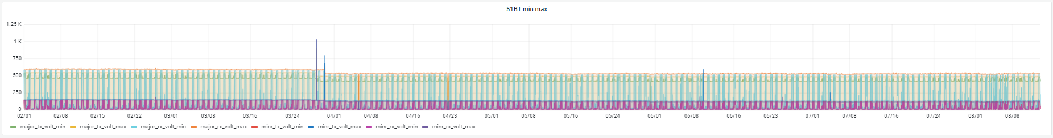
Descriptive Statistics
- Min, Max
실 데이터보다 적은 양으로, 데이터 자체의 특성 파악 가능

Slide 7
Descriptive Statistics
-Variance
Variance(편차 제곱의 평균) : 데이터가 평균에 가까울 수록 분산 작아짐(=데이터의 퍼진 정도)
단위를 맞춰 계산하기 때문에 직관적인 값 보기 어려워 표준편차 확인

Slide 8
Descriptive Statistics
-Standard Deviation
Standard Deviation (분산의 양의 제곱근) : 분산을 원래의 단위로 맞춰주는 과정 (=거리)
분산보다 데이터를 더 잘 확인 할 수 있음

Slide 9
Descriptive Statistics
-Python Code
def daterange(start_date, end_date):
for n in range(int((end_date - start_date).days)):
yield start_date + timedelta(n)
start_date = date(2021, 1, 20)
end_date = date(2021, 9, 4)
def Frame(date):
sdate = date.strftime("%Y%m%d000000000")
edate = (date + timedelta(days=1)).strftime("%Y%m%d000000000")
print(sdate, edate)
engine= create_engine('mysql+pymysql://idpw@localhost/table_name?charset=utf8', encoding='utf-8')
connection = engine.connect()
m_test = pd.read_sql("select * from value_tlds where date(dtct_ts) >= '%s' and date(dtct_ts) < '%s' " % (sdate, edate) connection)
connection.close()
table = m_test[['AREA_ID', 'DEV_GUBUN', 'DEV_NM','DTCT_TS','MAJOR_TX_VOLT','MAJOR_TX_VOLT_STATE','MINR_TX_VOLT',
'MINR_TX_VOLT_STATE','MAJOR_RX_VOLT','MAJOR_RX_VOLT_STATE','MINR_RX_VOLT','MINR_RX_VOLT_STATE']]
table=table.set_index('DTCT_TS')
df_summary = pd.DataFrame()
df_summary['MAJOR_TX_VOLT_MIN'] = table['MAJOR_TX_VOLT'].resample('1H').min()
df_summary['MAJOR_TX_VOLT_MAX'] = table['MAJOR_TX_VOLT'].resample('1H').max()
df_summary['MAJOR_TX_VOLT_AVG'] = table['MAJOR_TX_VOLT'].resample('1H').mean()
df_summary['MAJOR_TX_VOLT_VAR'] = table['MAJOR_TX_VOLT'].resample('1H').var()
df_summary['MAJOR_TX_VOLT_STD'] = np.sqrt(table['MAJOR_TX_VOLT'].resample('1H').var())
df_summary['MAJOR_RX_VOLT_MIN'] = table['MAJOR_RX_VOLT'].resample('1H').min()
df_summary['MAJOR_RX_VOLT_MAX'] = table['MAJOR_RX_VOLT'].resample('1H').max()
df_summary['MAJOR_RX_VOLT_AVG'] = table['MAJOR_RX_VOLT'].resample('1H').mean()
df_summary['MAJOR_RX_VOLT_VAR'] = table['MAJOR_RX_VOLT'].resample('1H').var()
df_summary['MAJOR_RX_VOLT_STD'] = np.sqrt(table['MAJOR_RX_VOLT'].resample('1H').var())
df_summary['MINR_RX_VOLT_MIN'] = table['MINR_RX_VOLT'].resample('1H').min()
df_summary['MINR_RX_VOLT_MAX'] = table['MINR_RX_VOLT'].resample('1H').max()
df_summary['MINR_RX_VOLT_AVG'] = table['MINR_RX_VOLT'].resample('1H').mean()
df_summary['MINR_RX_VOLT_VAR'] = table['MINR_RX_VOLT'].resample('1H').var()
df_summary['MINR_RX_VOLT_STD'] = np.sqrt(table['MINR_RX_VOLT'].resample('1H').var())
df_summary['area_id'] = 1
df_summary['dev_gubun'] = '100_TLDS_AF'
df_summary['dev_nm'] = 'DN2T'
a = table_test.MAJOR_TX_VOLT_STATE != '300_001'
table_test1=table_test.loc[a,:]
table_test2 = pd.DataFrame()
table_test2['MAJOR_TX_VOLT_ERROR'] = table_test1['MAJOR_TX_VOLT_STATE'].resample('1H').count()
merge_outer = df_summary.join(table_test2, how='outer')
merge_outer = merge_outer.astype({'MAJOR_TX_VOLT_ERROR':'object'})
merge_outer["MAJOR_TX_VOLT_ERROR"] = merge_outer.MAJOR_TX_VOLT_ERROR.fillna(0)
merge_outer = merge_outer.astype({'MAJOR_TX_VOLT_ERROR':'int'})
merge_outer
b = table.MAJOR_RX_VOLT_STATE != '300_001'
table_testb=table_test.loc[b,:]
table_testbb = pd.DataFrame()
table_testbb['MAJOR_RX_VOLT_ERROR'] = table_testb['MAJOR_TX_VOLT_STATE'].resample('1H').count()
merge_outer2 = merge_outer2.join(table_testbb, how='outer')
merge_outer2 = merge_outer2.astype({'MAJOR_RX_VOLT_ERROR':'object'})
merge_outer2["MAJOR_RX_VOLT_ERROR"] = merge_outer2.MAJOR_RX_VOLT_ERROR.fillna(0)
merge_outer2 = merge_outer2.astype({'MAJOR_RX_VOLT_ERROR':'int'})
merge_outer2
local_mariasql_url = create_engine('mysql+pymysql://ie:pw@localhost/table_name?charset=utf8',encoding='utf-8')
merge_outer2.to_sql(name='new_tlds_test', con=local_mariasql_url, index=False, if_exists='append')

Slide 10
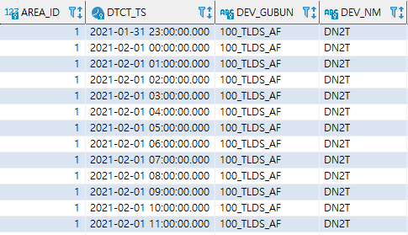
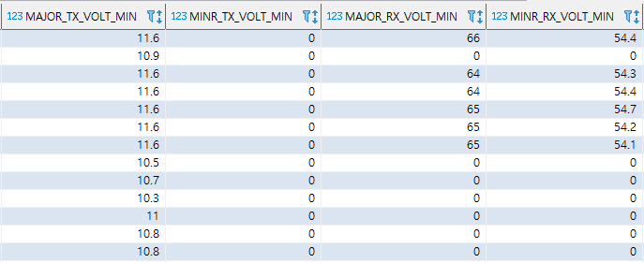
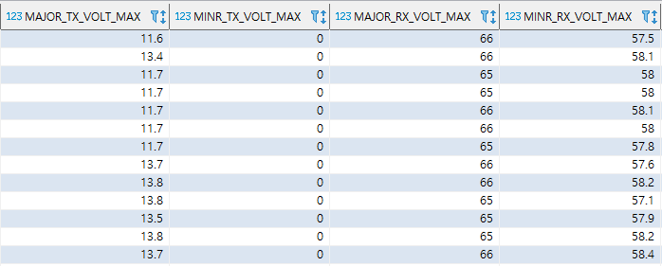
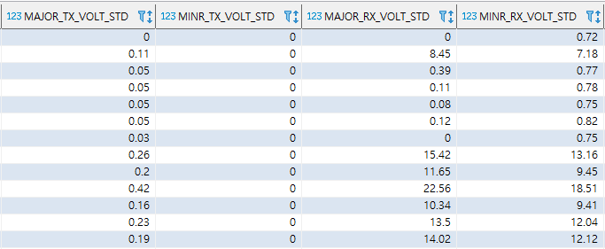
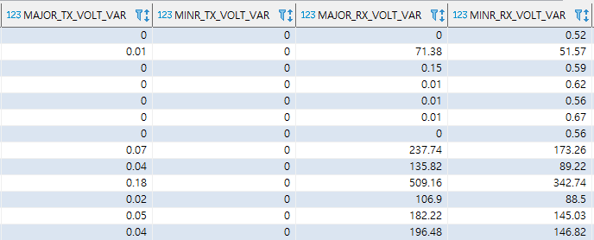
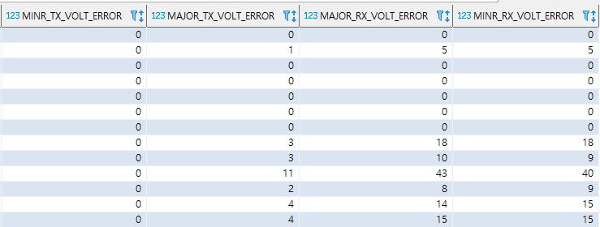
Descriptive Statistics
-Final Step
Table Name : New_tlds_test (1H)

Slide 11

PERCENTAGE DIAGNOSIS
- 전기설비기술지원시스템 상태 개수
설비 기준값
정상 상한, 하한 범위
주의 상한, 하한 범위
경고 상한, 하한 범위
장애 상한, 하한 범위

Slide 12
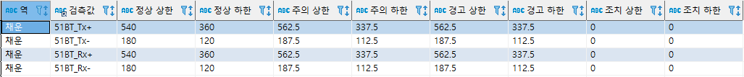
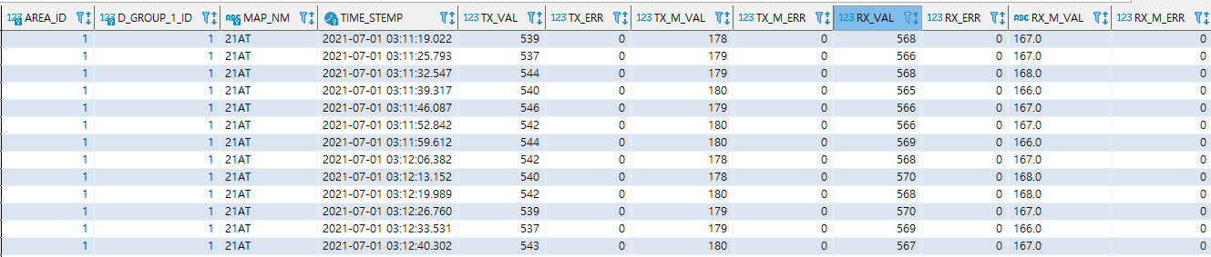
Descriptive Statistics
-Standard Deviation
● 전기설비기술지원시스템 설비기준값
● 전기설비기술지원시스템 상태 (0 : 정상, 2 : 주의 , 3 : 경고, 4 : 장애)

Slide 13
PERCENTAGE DIAGNOSIS UI
- 1 Day 기준

Slide 14
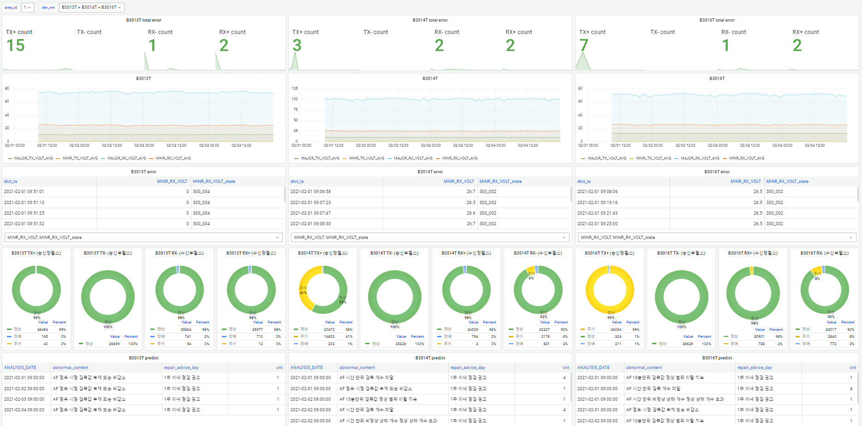
PERCENTAGE DASHBOARD UI
* Grafana DashBoard 분석 전 데이터 파악용도

Slide 15
CHANGE DETECTION
-Change Point Detection
출렁이는 구간
평균값 변화
잦은 변화
일시 변화
PYTHON – CUSUM (급격한 변화)

Slide 16
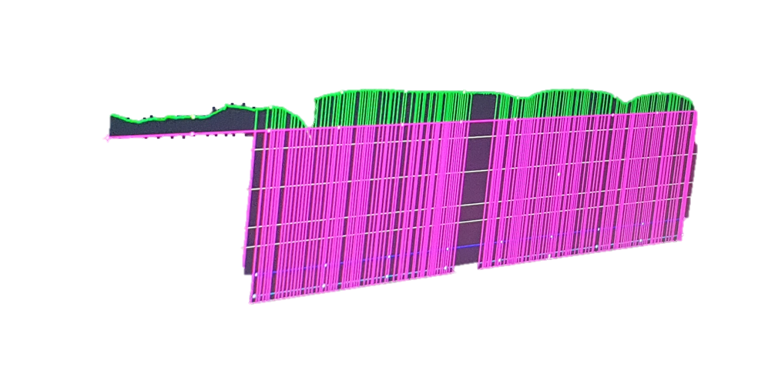
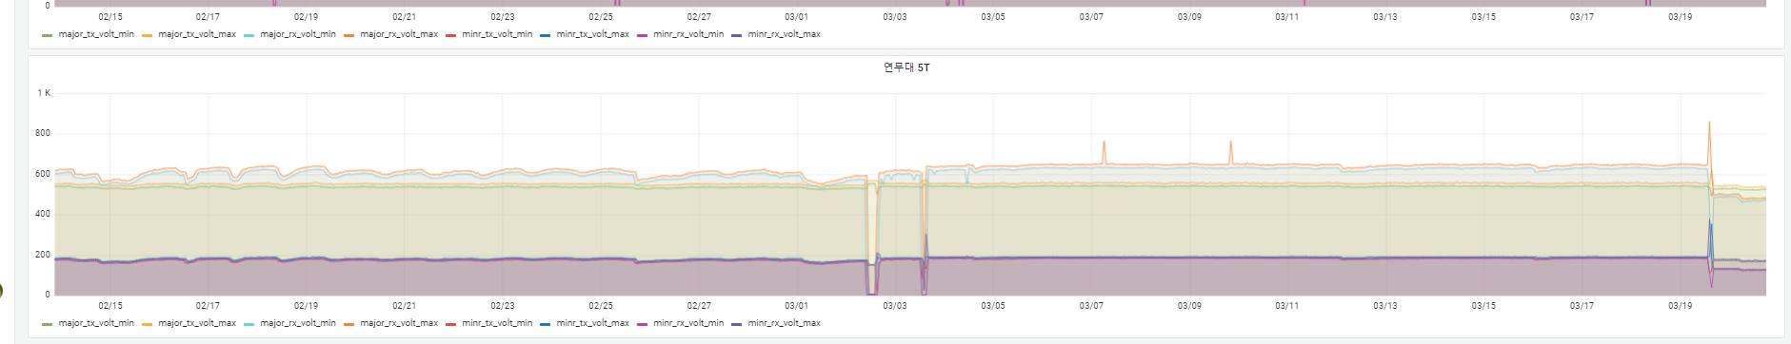
출렁이는 구간
● 천안아산
● 연무대 5T 2월 13일 ~ 3월 21일

Slide 17
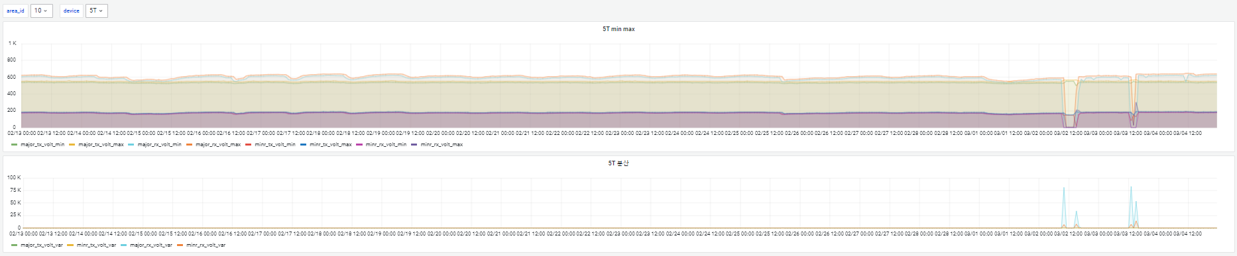
CHANGE DETECTION
- 출렁이는 구간
분산으로 잡히지 않음

Slide 18

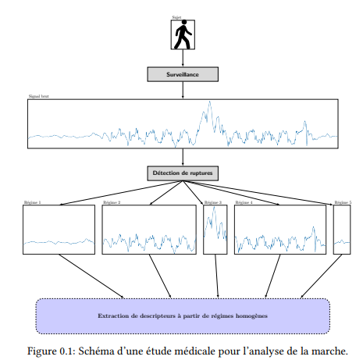
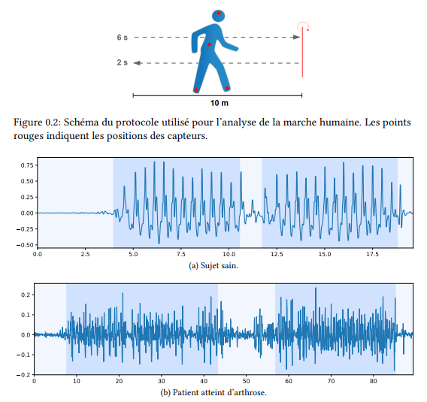
CHANGE DETECTION
하이퍼링크
- Change Point Detection
시계열 변화점 탐지
R – CPD
Python - Rupture

Slide 19
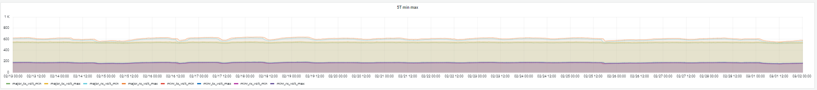
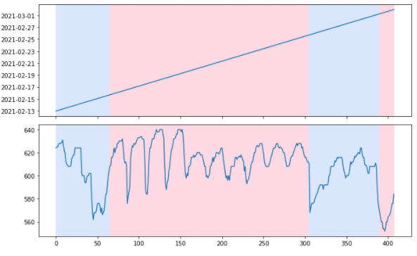
CHANGE DETECTION
- 연무대 5T 2월 13일~3월 1일
Python – Rupture
Model : Binseg
n_bkps : 3
평균이 변화한 지점 –> 3개의 구간 분할

Slide 20
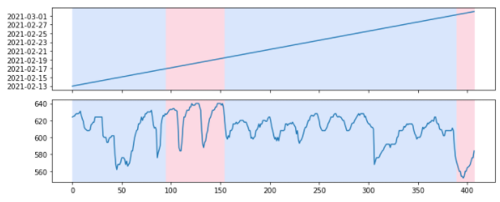
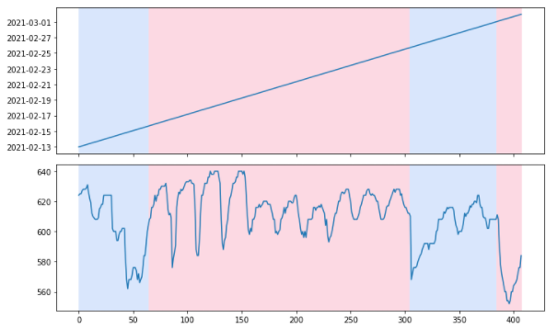
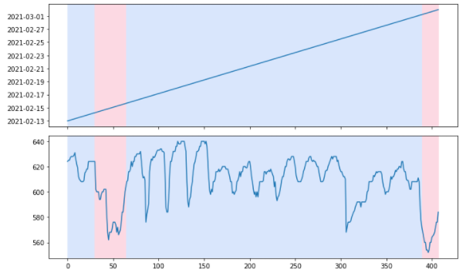
PYTHON - RUPTURE
- 논문 참고 및 모델의 성능 비교
● model : Dnpy , n_bkps : 3
● model : Window, n_bkps : 3
● model : Binseg, n_bkps : 3
● model : BottomUp, n_bkps : 3

Slide 21
CHANGE DETECTION
-Python Code
import pymysql
import cx_Oracle
from sqlalchemy import create_engine
import os
import datetime
from sqlalchemy.exc import IntegrityError
import ruptures as rpt
engine= create_engine('mysql+pymysql://id:pw@localhost/table_name?charset=utf8', encoding='utf-8')
connection = engine.connect()
TLDS = pd.read_sql("select * from sn001_phm.value_tlds where AREA_ID = 10 and DEV_NM like '5T' ", connection)
connection.close()
m_test=TLDS.set_index('DTCT_TS')
test = pd.DataFrame()
test['MAJOR_TX_VOLT_MIN'] = m_test['MAJOR_TX_VOLT'].resample('1H').min()
test['MAJOR_TX_VOLT_MAX'] = m_test['MAJOR_TX_VOLT'].resample('1H').max()
test['MINR_TX_VOLT_MIN'] = m_test['MINR_TX_VOLT'].resample('1H').min()
test['MINR_TX_VOLT_MAX'] = m_test['MINR_TX_VOLT'].resample('1H').max()
test['MAJOR_RX_VOLT_MIN'] = m_test['MAJOR_RX_VOLT'].resample('1H').min()
test['MAJOR_RX_VOLT_MAX'] = m_test['MAJOR_RX_VOLT'].resample('1H').max()
test['MINR_RX_VOLT_MIN'] = m_test['MINR_RX_VOLT'].resample('1H').min()
test['MINR_RX_VOLT_MAX'] = m_test['MINR_RX_VOLT'].resample('1H').max()
test['AREA_ID'] = 10
test['DEV_GUBUN'] = '100_TLDS_IMP'
test['DEV_NM'] = '5T'
test = test.fillna(0)
test['DTCT_TS'] = test.index
m = test[['MAJOR_RX_VOLT_MAX']]
m = m.reset_index()
signal = m
signal= signal.query("DTCT_TS >= '2021-02-13' and DTCT_TS < '2021-05-01'")
n_breaks = 40
y = np.array(signal['MAJOR_RX_VOLT_MAX'].tolist())
model = "l2“
algo = rpt.Binseg(model=model).fit(signal)
my_bkps = algo.predict(n_bkps=3)
rpt.show.display(signal, my_bkps, figsize=(10, 6))
plt.show()

Slide 22
TLDS
- STATE DIAGNOSIS
점유시 검측값 비감소
상태 기반 비율 진단
주파수 기준치 이상
비점유시 기준치 이상

Slide 23
점유시 검측값 비감소
- R code
condi_detect_type_1 <- data.frame()
item_map <- data.frame(ITEM_NM = c("MAJOR_TX_VOLT", "MINR_TX_VOLT", "MAJOR_RX_VOLT", "MINR_RX_VOLT"))
for (i in 2:nrow(item_map)) {
item_nm <- item_map[i, "ITEM_NM"]
data_for_condi <- tlds %>%
filter(hour(DTCT_TS) < CONDI_TABLE$EXCEPT_TS_LOWER , hour(DTCT_TS) >= CONDI_TABLE$EXCEPT_TS_UPPER) %>%
rename("VOLT"=item_nm) %>%
select(AREA_ID, DEV_GUBUN, DTCT_TS, DEV_NM, VOLT, OCCUPNCY_YN)
data_for_condi <- data_for_condi %>%
group_by(AREA_ID, DEV_GUBUN, DEV_NM) %>%
summarise(DTCT_TS = DTCT_TS,
VOLT = VOLT,
VOLT_LAG1 = lag(VOLT, 1),
OCCUPNCY_YN = OCCUPNCY_YN,
OCCUPNCY_YN_LAG1 = lag(OCCUPNCY_YN, 1)) %>%
ungroup() %>%
filter(OCCUPNCY_YN == 1 & (OCCUPNCY_YN_LAG1 == 0 | is.na(OCCUPNCY_YN_LAG1)))
add_data <- data_for_condi %>%
filter(OCCUPNCY_YN == 1 & is.na(OCCUPNCY_YN_LAG1))
add_value_tlds <- add_value_tlds_all %>%
rename("VOLT_LAG1" = item_nm) %>%
select(AREA_ID, DEV_GUBUN, DEV_NM, DTCT_TS, VOLT_LAG1, OCCUPNCY_YN_LAG1) %>%
drop_na(VOLT_LAG1) %>%
select(-DTCT_TS) %>%
as.data.frame()
add_data <- add_data %>%
select(-VOLT_LAG1, - OCCUPNCY_YN_LAG1) %>%
left_join(add_value_tlds, by = c("AREA_ID", "DEV_GUBUN", "DEV_NM")) %>%
drop_na(OCCUPNCY_YN_LAG1)
data_for_condi <- data_for_condi %>%
filter(OCCUPNCY_YN == 1 & OCCUPNCY_YN_LAG1 == 0) %>%
bind_rows(add_data)
data_for_condi <- data_for_condi %>%
filter(OCCUPNCY_YN == 1 & OCCUPNCY_YN_LAG1 == 0) %>%
filter(VOLT >= VOLT_LAG1) %>%
mutate(MSG = glue("{item_nm} 점유 전 : {VOLT_LAG1}, {item_nm} 점유 후 : {VOLT},")) %>%
mutate(CONDI_ID = ifelse(DEV_GUBUN == '100_TLDS_AF',
(CONDI_TABLE %>% filter(DEV_GUBUN == '100_TLDS_AF'))$CONDI_ID[1],
(CONDI_TABLE %>% filter(DEV_GUBUN == '100_TLDS_IMP'))$CONDI_ID[1]), ITEM_NM = item_nm) %>%
select(AREA_ID, DEV_GUBUN, DEV_NM, DTCT_TS, ITEM_NM, CONDI_ID, MSG)
condi_detect_type_1 <- bind_rows(condi_detect_type_1, data_for_condi)
}
condi_detect_type_1
<- dcast(condi_detect_type_1, AREA_ID+DEV_GUBUN+DEV_NM+DTCT_TS+CONDI_ID~ITEM_NM, value.var = "MSG")
condi_detect_type_1 <- condi_detect_type_1 %>%
unite(MSG, condi_detect_type_1 %>%
select(-c(AREA_ID, DEV_GUBUN, DEV_NM, DTCT_TS, CONDI_ID)) %>% names(), sep = ' ') %>%
mutate(MSG = str_remove_all(glue(‘“ DTCT_TS ”: “ {DTCT_TS} ”, “MSG” : “{MSG} ”"),'NA')) %>%
mutate(MSG = paste("{",MSG, "}", sep=""))

Slide 24
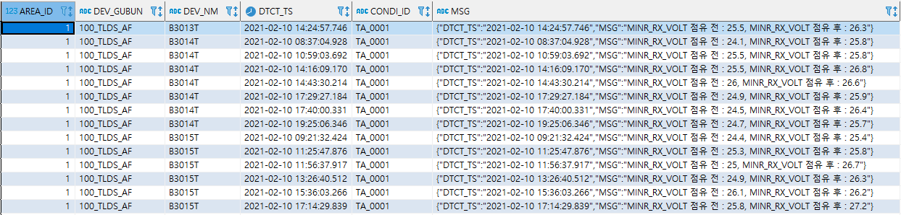
점유시 검측값 비감소
- Final Step
Table Name : ret_condi_test1
Host : 192.168.111.143 sn001_phm

Slide 25
상태 기반 비율 진단
- R code
condi_detect_type_2 <- data.frame()
item_map <- data.frame(ITEM_NM = c("MAJOR_TX_VOLT", "MINR_TX_VOLT", "MAJOR_RX_VOLT", "MINR_RX_VOLT"))
data_for_condi <- tlds %>%
filter(hour(DTCT_TS) < 22 , hour(DTCT_TS) >= 4) %>%
mutate(DTCT_TS = time.root[roop, "MIN_DTCT_TS"]) %>%
filter(OCCUPNCY_YN != 1) %>%
select(AREA_ID, DTCT_TS, DEV_GUBUN, DEV_NM, contains("_STATE"))
for (i in 1:nrow(item_map)) {
item_nm <- paste0(item_map[i, "ITEM_NM"], "_STATE")
condi_id <- item_map[i, "CONDI_ID"]
data_for_condi_one <- data_for_condi %>%
select(c("AREA_ID", "DTCT_TS", "DEV_GUBUN", "DEV_NM", item_nm)) %>%
group_by(AREA_ID, DTCT_TS, DEV_GUBUN, DEV_NM) %>%
summarise(NORMAL_CNT = sum(get(item_nm) == "300_001", na.rm = T),
ATTN_CNT = sum(get(item_nm) == "300_002", na.rm = T),
WARN_CNT = sum(get(item_nm) == "300_003", na.rm = T),
DL_CNT = sum(get(item_nm) == "300_004", na.rm = T),) %>%
ungroup() %>%
mutate(nol_prop = round(NORMAL_CNT/(NORMAL_CNT+DL_CNT) * 100,2), sl_prop = round(DL_CNT/(NORMAL_CNT+DL_CNT) * 100,2)) %>%
filter(sl_prop >= 40) %>%
mutate(CONDI_ID = CONDI_TABLE$CONDI_ID[2], MSG = glue(‘” 정상” : {NORMAL_CNT}, ”주의” : {ATTN_CNT}, ”경고”: {WARN_CNT}, ”장애”: {DL_CNT}' )) %>%
mutate(MSG = paste("{", MSG, "}", sep = ""))
condi_detect_type_2 <- bind_rows(condi_detect_type_2, data_for_condi_one) %>%
select(AREA_ID, DEV_GUBUN, DEV_NM, DTCT_TS, CONDI_ID, MSG)

Slide 26
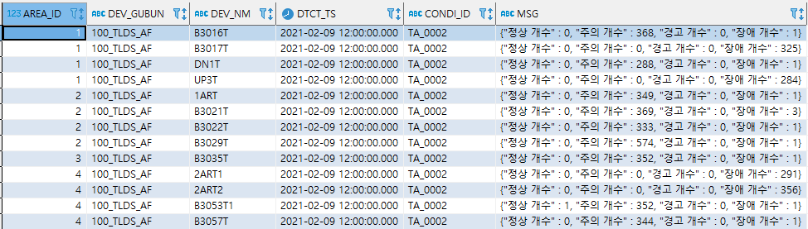
상태 기반 비율 진단
- Final Step
Table Name : ret_condi_test2 (1H)
Host : 192.168.111.143 sn001_phm

Slide 27
주파수 기준치 이상
- R code
condi_detect_type_3 <- data.frame()
item_map <- data.frame(ITEM_NM = c('R1_DC'))
for (i in 1:nrow(item_map)){
item_nm <- item_map[i, "ITEM_NM"]
data_for_condi_one <- tlds %>% filter(hour(DTCT_TS) < 22 , hour(DTCT_TS) >= 4) %>% left_join(tlds %>%
mutate(DTCT_TS2 = DTCT_TS %>% substr(1, 13) %>% paste0(":00:00.0001") %>% ymd_hms(tz = "Asia/Seoul")) %>%
group_by(AREA_ID, DTCT_TS2, DEV_GUBUN, DEV_NM) %>%
mutate(DIFF = get(item_nm) - shift(get(item_nm))) %>%
filter(DIFF == 0) %>%
ungroup() %>%
select(AREA_ID, DEV_NM, item_nm) %>%
rename(STANDARD = item_nm) %>% unique()) %>%
filter(abs(get(item_nm) - STANDARD) > 0.2) %>%
mutate(CONDI_ID = (CONDI_TABLE %>%
filter(DEV_GUBUN =='100_TLDS_IMP'))$CONDI_ID[3], MSG = glue('”주파수 기준값 이상”: {get(item_nm)}' )) %>%
select(-STANDARD)
condi_detect_type_3 <- bind_rows(condi_detect_type_3, data_for_condi_one)
}

Slide 28
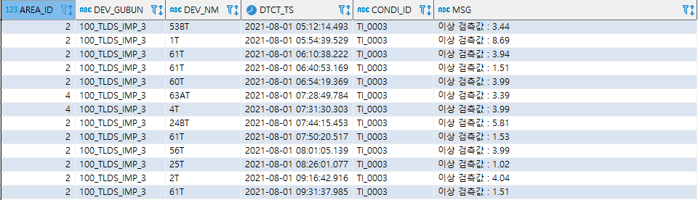
주파수 기준치 이상
- Final Step
Table Name : ret_condi_test3
Host : 192.168.111.143 sn001_phm

Slide 29
비점유시 기준치 이상
- R code
condi_detect_type_4 <- data.frame()
item_map <- data.frame(ITEM_NM = c('MAJOR_TX_VOLT', 'MINR_TX_VOLT', 'MAJOR_RX_VOLT', 'MINR_RX_VOLT'))
major_tx <- dbGetQuery(con, glue("select a.AREA_ID, a.DEV_NM, a.MAJOR_TX_VOLT_UPPER,a.MAJOR_TX_VOLT_LOWER
from (SELECT ps.AREA_ID, ps.ITEM_NM AS DEV_NM ,
case when SUBSTRING_INDEX(ps.ITEM_SUB_NM , '_', -1) like 'Tx+' then pss.LOWER_LIMIT_D else null end as 'MAJOR_TX_VOLT_LOWER',
case when SUBSTRING_INDEX(ps.ITEM_SUB_NM , '_', -1) like 'Tx+' then pss.UPPER_LIMIT_D else null end as 'MAJOR_TX_VOLT_UPPER'
from sn001_phm.protocol_spec ps
join protocol_spec_set pss on ps.PROTOCOL_ID = pss.PROTOCOL_ID
where SYS_ID = 102
and MAPPING_USE = 1
and ITEM_SUB_NM not like '%V%'
group by ps.AREA_ID,ps.ITEM_NM, SUBSTRING_INDEX(ps.ITEM_SUB_NM , '_', -1)) a
where length( a.MAJOR_TX_VOLT_UPPER) >0 "))
minr_tx <- dbGetQuery(con, glue("select a.AREA_ID, a.DEV_NM, a.MINR_TX_VOLT_UPPER,a.MINR_TX_VOLT_LOWER
from (SELECT ps.AREA_ID, ps.ITEM_NM AS DEV_NM ,
case when SUBSTRING_INDEX(ps.ITEM_SUB_NM , '_', -1) like 'Tx-' then pss.LOWER_LIMIT_D else null end as 'MINR_TX_VOLT_LOWER',
case when SUBSTRING_INDEX(ps.ITEM_SUB_NM , '_', -1) like 'Tx-' then pss.UPPER_LIMIT_D else null end as 'MINR_TX_VOLT_UPPER'
from sn001_phm.protocol_spec ps
join protocol_spec_set pss on ps.PROTOCOL_ID = pss.PROTOCOL_ID
where SYS_ID = 102
and MAPPING_USE = 1
and ITEM_SUB_NM not like '%V%'
group by ps.AREA_ID,ps.ITEM_NM, SUBSTRING_INDEX(ps.ITEM_SUB_NM , '_', -1)) as a
where length( a.MINR_TX_VOLT_UPPER) >0 "))
major_rx <- dbGetQuery(con, glue("select a.AREA_ID, a.DEV_NM, a.MAJOR_RX_VOLT_UPPER, a.MAJOR_RX_VOLT_LOWER
from (SELECT ps.AREA_ID, ps.ITEM_NM AS DEV_NM ,
case when SUBSTRING_INDEX(ps.ITEM_SUB_NM , '_', -1) like 'Rx+' then pss.LOWER_LIMIT_D else null end as 'MAJOR_RX_VOLT_LOWER',
case when SUBSTRING_INDEX(ps.ITEM_SUB_NM , '_', -1) like 'Rx+' then pss.UPPER_LIMIT_D else null end as 'MAJOR_RX_VOLT_UPPER'
from sn001_phm.protocol_spec ps
join protocol_spec_set pss on ps.PROTOCOL_ID = pss.PROTOCOL_ID
where SYS_ID = 102
and MAPPING_USE = 1
and ITEM_SUB_NM not like '%V%'
group by ps.AREA_ID,ps.ITEM_NM, SUBSTRING_INDEX(ps.ITEM_SUB_NM , '_', -1)) as a
where length( a.MAJOR_RX_VOLT_UPPER) >0 "))
minr_rx <- dbGetQuery(con, glue("select a.AREA_ID, a.DEV_NM, a.MINR_RX_VOLT_UPPER,a.MINR_RX_VOLT_LOWER
from (SELECT ps.AREA_ID, ps.ITEM_NM AS DEV_NM ,
case when SUBSTRING_INDEX(ps.ITEM_SUB_NM , '_', -1) like 'Rx-' then pss.LOWER_LIMIT_D else null end as 'MINR_RX_VOLT_LOWER',
case when SUBSTRING_INDEX(ps.ITEM_SUB_NM , '_', -1) like 'Rx-' then pss.UPPER_LIMIT_D else null end as 'MINR_RX_VOLT_UPPER'
from sn001_phm.protocol_spec ps
join protocol_spec_set pss on ps.PROTOCOL_ID = pss.PROTOCOL_ID
where SYS_ID = 102
and MAPPING_USE = 1
and ITEM_SUB_NM not like '%V%'
group by ps.AREA_ID,ps.ITEM_NM, SUBSTRING_INDEX(ps.ITEM_SUB_NM , '_', -1)) as a
where length( a.MINR_RX_VOLT_UPPER) >0 "))
aa <- major_tx %>% full_join(minr_tx)
aa <- aa %>% full_join(major_rx)
aa <- aa %>% full_join(minr_rx)
total <- tlds %>% full_join(aa)
for (i in 1:nrow(item_map)){
item_nm <- item_map[i, "ITEM_NM"]
item_nm_U <- paste0(item_map[i, "ITEM_NM"], "_UPPER")
item_nm_L <- paste0(item_map[i, "ITEM_NM"], "_LOWER")
data_for_condi_test <- total %>%
filter(hour(DTCT_TS) < CONDI_TABLE$EXCEPT_TS_LOWER , hour(DTCT_TS) >= CONDI_TABLE$EXCEPT_TS_UPPER) %>%
rename("VOLT"=item_nm) %>%
filter(OCCUPNCY_YN==0) %>%
select(AREA_ID, DEV_GUBUN, DTCT_TS, DEV_NM, VOLT, OCCUPNCY_YN, item_nm_L,item_nm_U )
data_for_condi_test[, 7] = as.numeric(data_for_condi_test[, 7])
data_for_condi_test[, 8] = as.numeric(data_for_condi_test[, 8])
error <- data_for_condi_test %>%
filter(get(item_nm_L) > VOLT | get(item_nm_U) < VOLT) %>%
filter(get(item_nm_L) > 0 | get(item_nm_U) > 0)
error2 <- error %>%
group_by(AREA_ID, DTCT_TS,DEV_GUBUN, DEV_NM)
error2 <- cbind(error2, hour = substr(error2$DTCT_TS, 1, 13))
error3 <- error2 %>%
group_by(AREA_ID, hour, DEV_GUBUN, DEV_NM) %>%
summarise(n = n() , na.rm = T)
data_for_condi4 <- error3 %>%
mutate(MSG = glue("{item_nm} 이상 개수 : {n}")) %>%
mutate(CONDI_ID = ifelse(DEV_GUBUN == '100_TLDS_AF',
(CONDI_TABLE %>% filter(DEV_GUBUN == '100_TLDS_AF'))$CONDI_ID[2],
(CONDI_TABLE %>% filter(DEV_GUBUN == '100_TLDS_IMP'))$CONDI_ID[2]), ITEM_NM = item_nm) %>%
select(AREA_ID, DEV_GUBUN,ITEM_NM, DEV_NM, hour, CONDI_ID, MSG)
condi_detect_type_4 <- bind_rows(condi_detect_type_4, data_for_condi4)
}
condi_detect_type_test <- dcast(condi_detect_type_4, AREA_ID+DEV_GUBUN+DEV_NM+hour+CONDI_ID~ITEM_NM, value.var = "MSG")
condi_detect_type_test <- condi_detect_type_test %>%
unite(MSG, condi_detect_type_test %>% select(-c(AREA_ID,DEV_GUBUN, DEV_NM, hour, CONDI_ID)) %>% names(), sep = ' ') %>%
mutate(MSG = str_remove_all(glue("시간 : {hour}, {MSG}"),'NA')) %>%
mutate(MSG = paste("{",MSG, "}", sep=""))

Slide 30
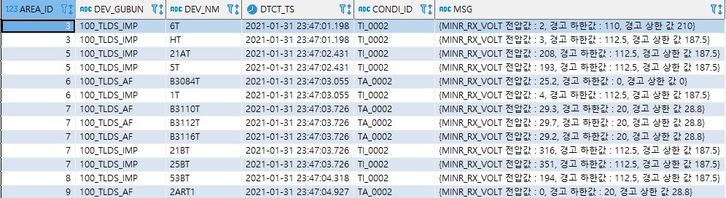
비점유시 기준치 이상
- Final Step ver.1
Table Name : ret_condi_test4
Host : 192.168.111.143 sn001_phm

Slide 31
비점유시 기준치 이상
- R code
condi_detect_type_4 <- data.frame()
item_map <- data.frame(ITEM_NM = c('MAJOR_TX_VOLT', 'MINR_TX_VOLT', 'MAJOR_RX_VOLT', 'MINR_RX_VOLT'))
major_tx <- dbGetQuery(con, glue("select a.AREA_ID, a.DEV_NM, a.MAJOR_TX_VOLT_UPPER,a.MAJOR_TX_VOLT_LOWER
from (SELECT ps.AREA_ID, ps.ITEM_NM AS DEV_NM ,
case when SUBSTRING_INDEX(ps.ITEM_SUB_NM , '_', -1) like 'Tx+' then pss.LOWER_LIMIT_D else null end as 'MAJOR_TX_VOLT_LOWER',
case when SUBSTRING_INDEX(ps.ITEM_SUB_NM , '_', -1) like 'Tx+' then pss.UPPER_LIMIT_D else null end as 'MAJOR_TX_VOLT_UPPER'
from sn001_phm.protocol_spec ps
join protocol_spec_set pss on ps.PROTOCOL_ID = pss.PROTOCOL_ID
where SYS_ID = 102
and MAPPING_USE = 1
and ITEM_SUB_NM not like '%V%'
group by ps.AREA_ID,ps.ITEM_NM, SUBSTRING_INDEX(ps.ITEM_SUB_NM , '_', -1)) a
where length( a.MAJOR_TX_VOLT_UPPER) >0 "))
minr_tx <- dbGetQuery(con, glue("select a.AREA_ID, a.DEV_NM, a.MINR_TX_VOLT_UPPER,a.MINR_TX_VOLT_LOWER
from (SELECT ps.AREA_ID, ps.ITEM_NM AS DEV_NM ,
case when SUBSTRING_INDEX(ps.ITEM_SUB_NM , '_', -1) like 'Tx-' then pss.LOWER_LIMIT_D else null end as 'MINR_TX_VOLT_LOWER',
case when SUBSTRING_INDEX(ps.ITEM_SUB_NM , '_', -1) like 'Tx-' then pss.UPPER_LIMIT_D else null end as 'MINR_TX_VOLT_UPPER'
from sn001_phm.protocol_spec ps
join protocol_spec_set pss on ps.PROTOCOL_ID = pss.PROTOCOL_ID
where SYS_ID = 102
and MAPPING_USE = 1
and ITEM_SUB_NM not like '%V%'
group by ps.AREA_ID,ps.ITEM_NM, SUBSTRING_INDEX(ps.ITEM_SUB_NM , '_', -1)) as a
where length( a.MINR_TX_VOLT_UPPER) >0 "))
major_rx <- dbGetQuery(con, glue("select a.AREA_ID, a.DEV_NM, a.MAJOR_RX_VOLT_UPPER, a.MAJOR_RX_VOLT_LOWER
from (SELECT ps.AREA_ID, ps.ITEM_NM AS DEV_NM ,
case when SUBSTRING_INDEX(ps.ITEM_SUB_NM , '_', -1) like 'Rx+' then pss.LOWER_LIMIT_D else null end as 'MAJOR_RX_VOLT_LOWER',
case when SUBSTRING_INDEX(ps.ITEM_SUB_NM , '_', -1) like 'Rx+' then pss.UPPER_LIMIT_D else null end as 'MAJOR_RX_VOLT_UPPER'
from sn001_phm.protocol_spec ps
join protocol_spec_set pss on ps.PROTOCOL_ID = pss.PROTOCOL_ID
where SYS_ID = 102
and MAPPING_USE = 1
and ITEM_SUB_NM not like '%V%'
group by ps.AREA_ID,ps.ITEM_NM, SUBSTRING_INDEX(ps.ITEM_SUB_NM , '_', -1)) as a
where length( a.MAJOR_RX_VOLT_UPPER) >0 "))
minr_rx <- dbGetQuery(con, glue("select a.AREA_ID, a.DEV_NM, a.MINR_RX_VOLT_UPPER,a.MINR_RX_VOLT_LOWER
from (SELECT ps.AREA_ID, ps.ITEM_NM AS DEV_NM ,
case when SUBSTRING_INDEX(ps.ITEM_SUB_NM , '_', -1) like 'Rx-' then pss.LOWER_LIMIT_D else null end as 'MINR_RX_VOLT_LOWER',
case when SUBSTRING_INDEX(ps.ITEM_SUB_NM , '_', -1) like 'Rx-' then pss.UPPER_LIMIT_D else null end as 'MINR_RX_VOLT_UPPER'
from sn001_phm.protocol_spec ps
join protocol_spec_set pss on ps.PROTOCOL_ID = pss.PROTOCOL_ID
where SYS_ID = 102
and MAPPING_USE = 1
and ITEM_SUB_NM not like '%V%'
group by ps.AREA_ID,ps.ITEM_NM, SUBSTRING_INDEX(ps.ITEM_SUB_NM , '_', -1)) as a
where length( a.MINR_RX_VOLT_UPPER) >0 "))
aa <- major_tx %>% full_join(minr_tx)
aa <- aa %>% full_join(major_rx)
aa <- aa %>% full_join(minr_rx)
total <- tlds %>% full_join(aa)
for (i in 1:nrow(item_map)){
item_nm <- item_map[i, "ITEM_NM"]
item_nm_U <- paste0(item_map[i, "ITEM_NM"], "_UPPER")
item_nm_L <- paste0(item_map[i, "ITEM_NM"], "_LOWER")
data_for_condi_test <- total %>%
filter(hour(DTCT_TS) < CONDI_TABLE$EXCEPT_TS_LOWER , hour(DTCT_TS) >= CONDI_TABLE$EXCEPT_TS_UPPER) %>%
rename("VOLT"=item_nm) %>%
filter(OCCUPNCY_YN==0) %>%
select(AREA_ID, DEV_GUBUN, DTCT_TS, DEV_NM, VOLT, OCCUPNCY_YN, item_nm_L,item_nm_U )
data_for_condi_test[, 7] = as.numeric(data_for_condi_test[, 7])
data_for_condi_test[, 8] = as.numeric(data_for_condi_test[, 8])
error <- data_for_condi_test %>%
filter(get(item_nm_L) > VOLT | get(item_nm_U) < VOLT) %>%
filter(get(item_nm_L) > 0 | get(item_nm_U) > 0)
error2 <- error %>%
group_by(AREA_ID, DTCT_TS,DEV_GUBUN, DEV_NM)
error2 <- cbind(error2, hour = substr(error2$DTCT_TS, 1, 13))
error3 <- error2 %>%
group_by(AREA_ID, hour, DEV_GUBUN, DEV_NM) %>%
summarise(n = n() , na.rm = T)
data_for_condi4 <- error3 %>%
mutate(MSG = glue("{item_nm} 기준치 이상 개수 : {n}")) %>%
mutate(CONDI_ID = ifelse(DEV_GUBUN == '100_TLDS_AF',
(CONDI_TABLE %>% filter(DEV_GUBUN == '100_TLDS_AF'))$CONDI_ID[2],
(CONDI_TABLE %>% filter(DEV_GUBUN == '100_TLDS_IMP'))$CONDI_ID[2]), ITEM_NM = item_nm) %>%
select(AREA_ID, DEV_GUBUN,ITEM_NM, DEV_NM, hour, CONDI_ID, MSG)
condi_detect_type_4 <- bind_rows(condi_detect_type_4, data_for_condi4)
}
condi_detect_type_test <- dcast(condi_detect_type_4, AREA_ID+DEV_GUBUN+DEV_NM+hour+CONDI_ID~ITEM_NM, value.var = "MSG")
condi_detect_type_test <- condi_detect_type_test %>%
unite(MSG, condi_detect_type_test %>% select(-c(AREA_ID,DEV_GUBUN, DEV_NM, hour, CONDI_ID)) %>% names(), sep = ' ') %>%
mutate(MSG = str_remove_all(glue(‘”DTCT_TS” : “{hour}”, “MSG” : “{MSG}“’),'NA')) %>%
mutate(MSG = paste("{",MSG, "}", sep=""))

Slide 32
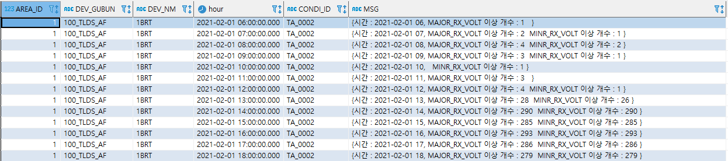
비점유시 기준치 이상
- Final Step ver.2 (count)
Table Name : ret_condi_test5 (1H)
Host : 192.168.111.143 sn001_phm

Slide 33
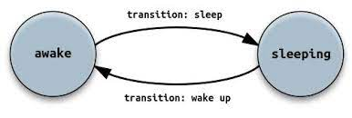
FSM
-Finite State Machine
상태 전이 테이블

Slide 34
FSM
- Finite State Machine
상태 : 각각의 상태는 고유의 ACTION 가지고 있음
상태 전이 : 현재 상태에서 다른 상태로 변화하는 것
이벤트 : 상태 전이를 위한 조건
상태전환표 or STATE PATTERN
목적 : 상태전이 테이블로 중복 제거
컨셉이 이해가 잘 안됨
현재 상태 | 이벤트 | 상태 전환
INPUT_VOLT | 기준값 초과/미만 | + 1
 | 기준값 이내 | PASS or + 0

Slide 35
About idea
- Incident Category
수신 임피던스
송신 임피던스
송신기
수신기

Slide 36
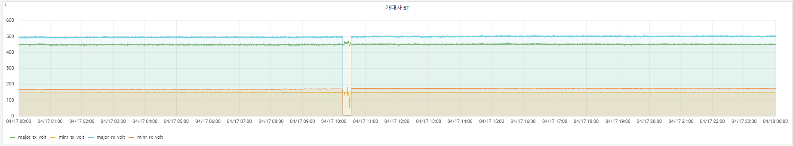
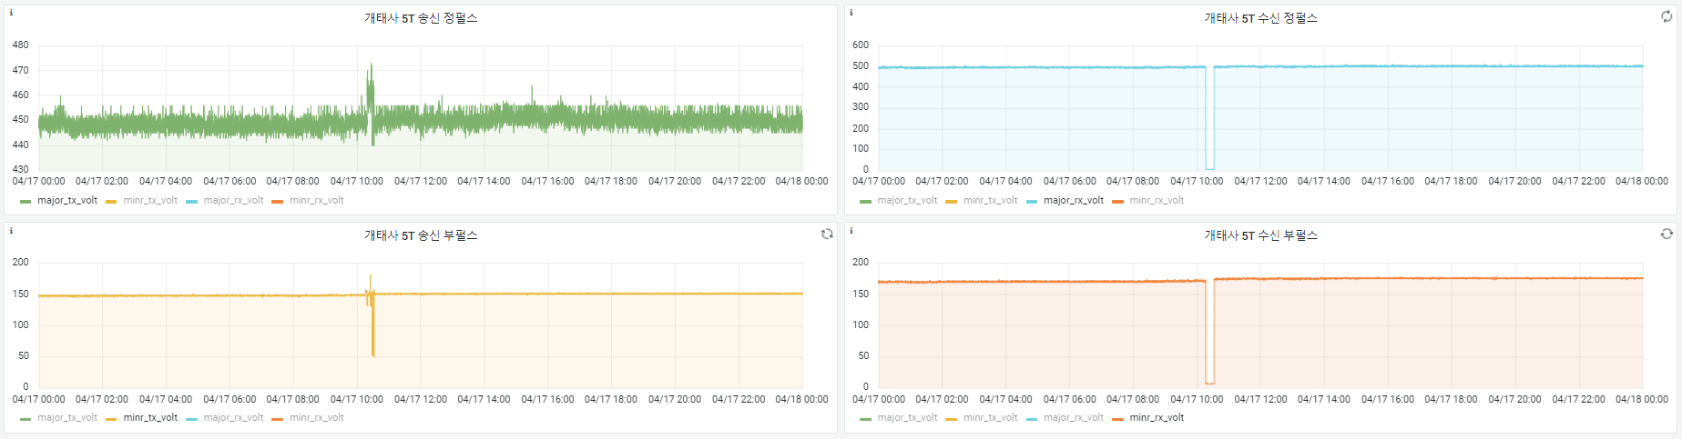
수신 임피던스 불량
-개태사 5T 2021-04-17(토)

Slide 37
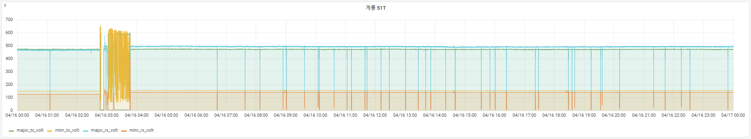
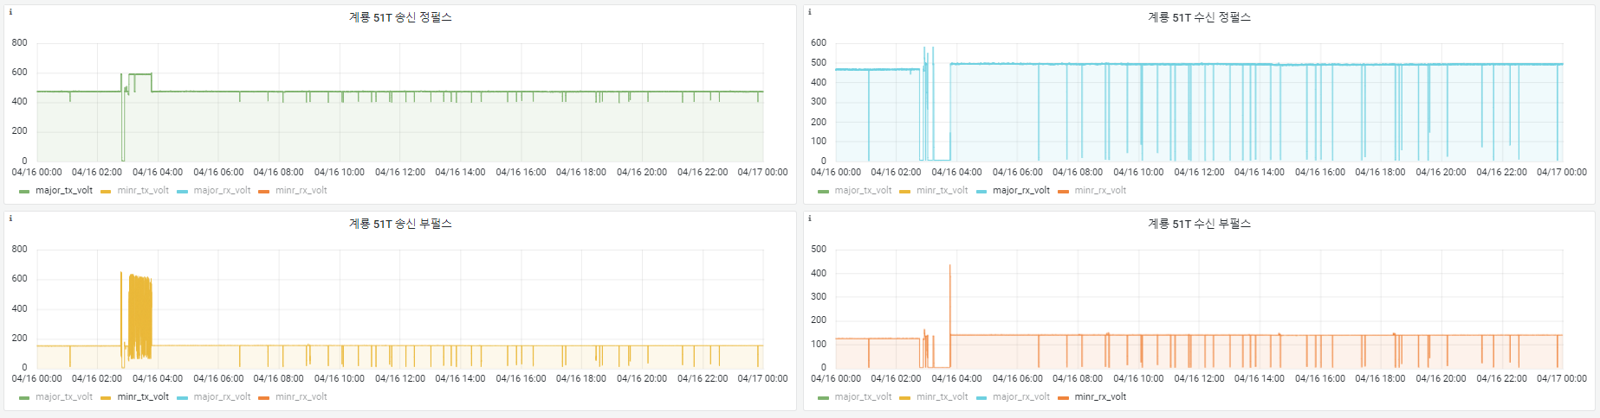
송신 임피던스 불량
-계룡 51T 2021-04-16(금)

Slide 38
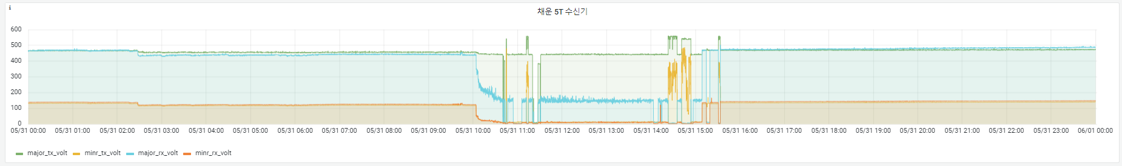
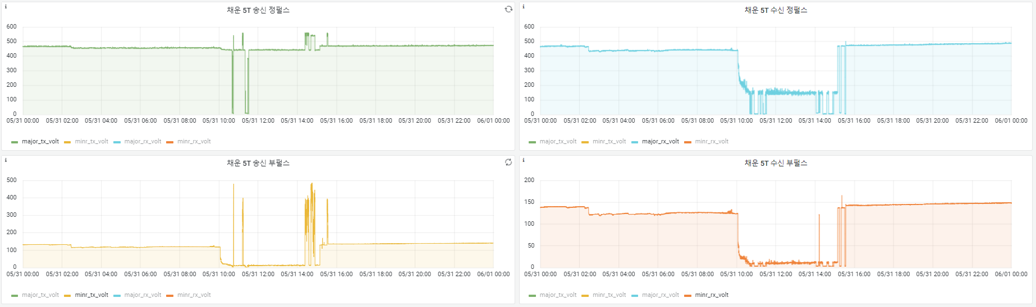
수신기 불량
-채운 5T 2021-05-31(월)

Slide 39
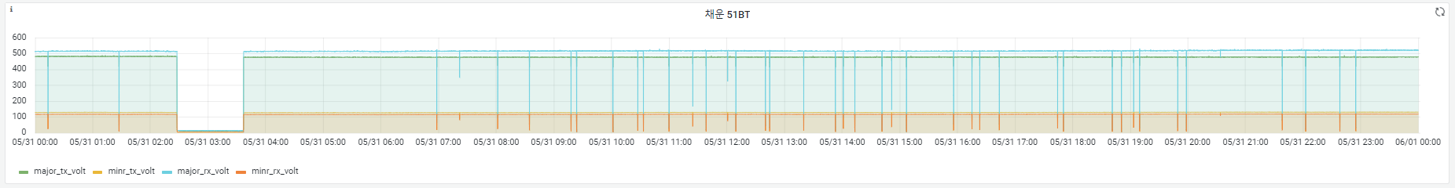
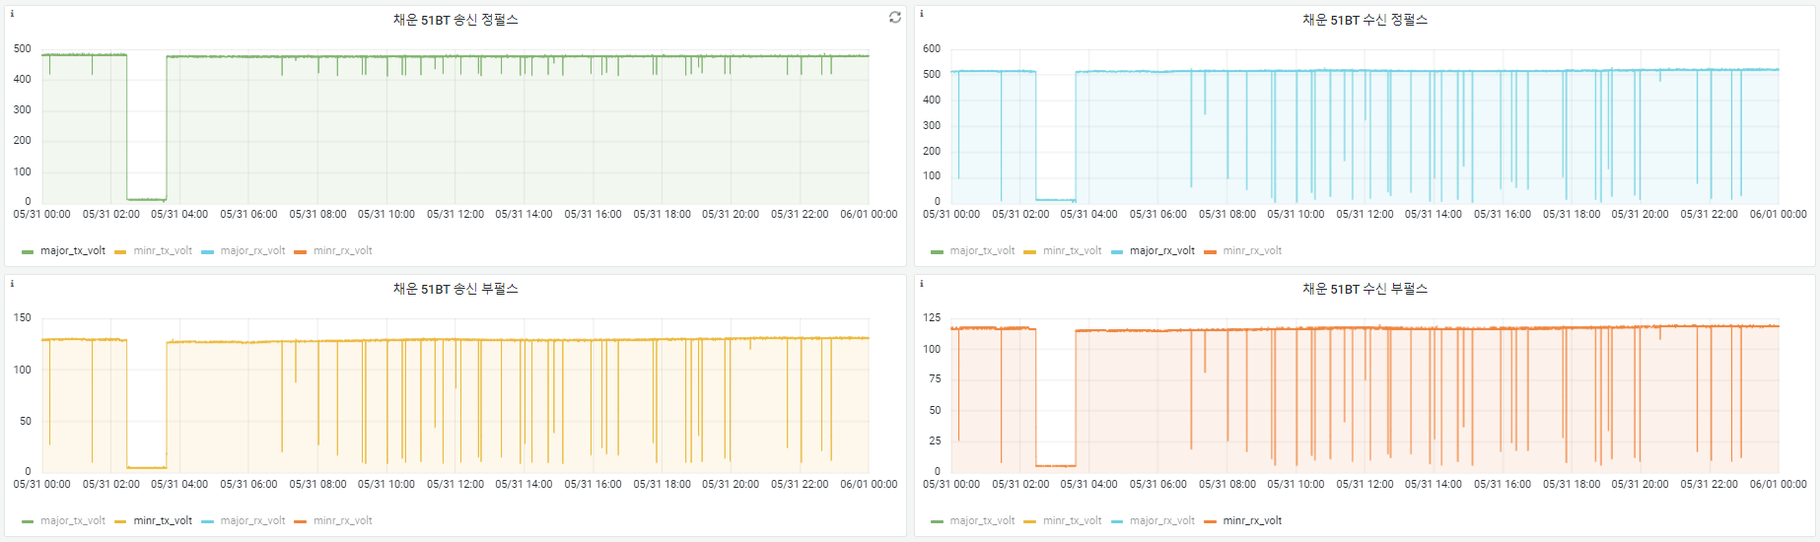
송신기 불량
-채운 51BT 2021-05-31(월)

Slide 40
Incident Category
- 1 Month
정답(=라벨링) 으로 딥러닝 예측
 | DATE | ERROR | COUNT
서대전 | 2월 | 수신 임피던스 | 2
가수원 |  | - | -
흑석리 |  | 송신기 | 1
계룡 |  | 수신기 | 1
개태사 |  | 송신 임피던스 | 1
연산 |  | - | -
논산 |  | 수신 임피던스 | 1
채운 |  | 송신기 | 2
강경 |  | - | -
연무대 |  | - | -

Slide 41
MOVING AVERAGE
- DEVICE ANANLYSIS
IMP
AF
장애 캘린더

Slide 42
MOVING AVERAGE
- 정의 및 개념
정의 : 전체 데이터 집합의 여러 하위 집합에 대한 일련의 평균을 만들어 데이터 요소 분석
신호의 변화 추이 파악에 용이
노이즈 제거를 하려면 칼만 필터 적용

Slide 43
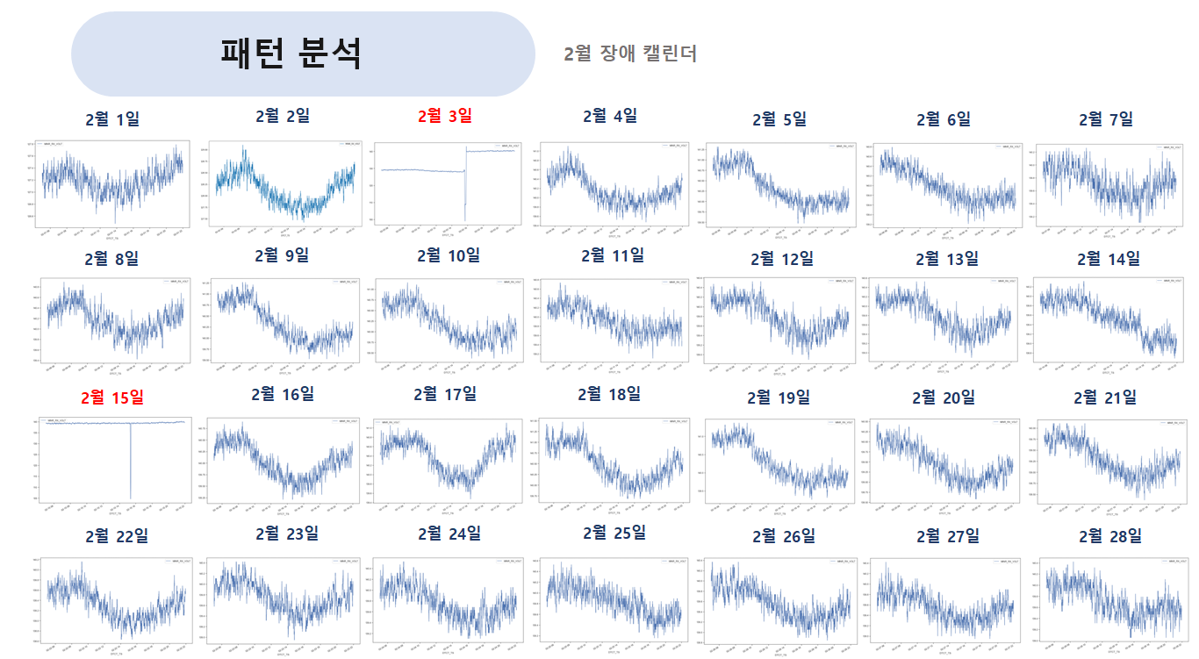
MOVING AVERAGE
- 서대전 IMP 60T 2월

Slide 44
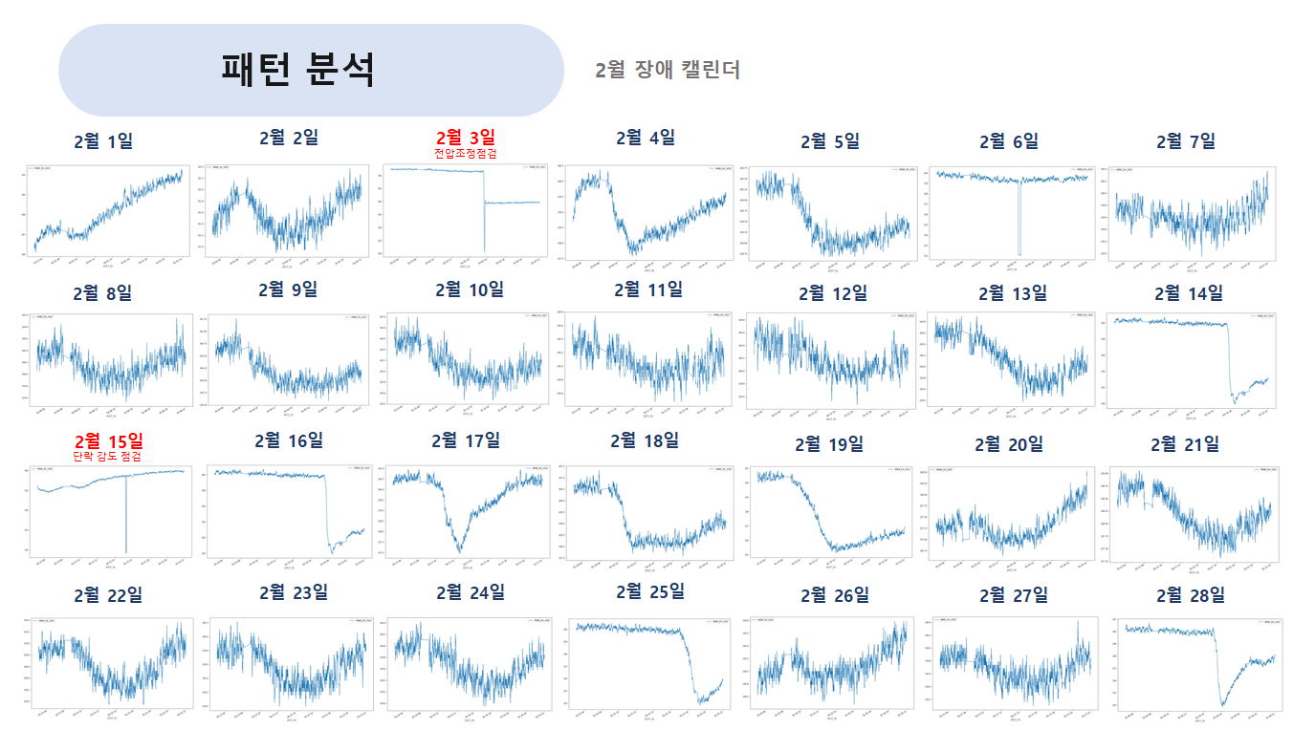
MOVING AVERAGE
- 서대전 IMP 4T 2월

Slide 45
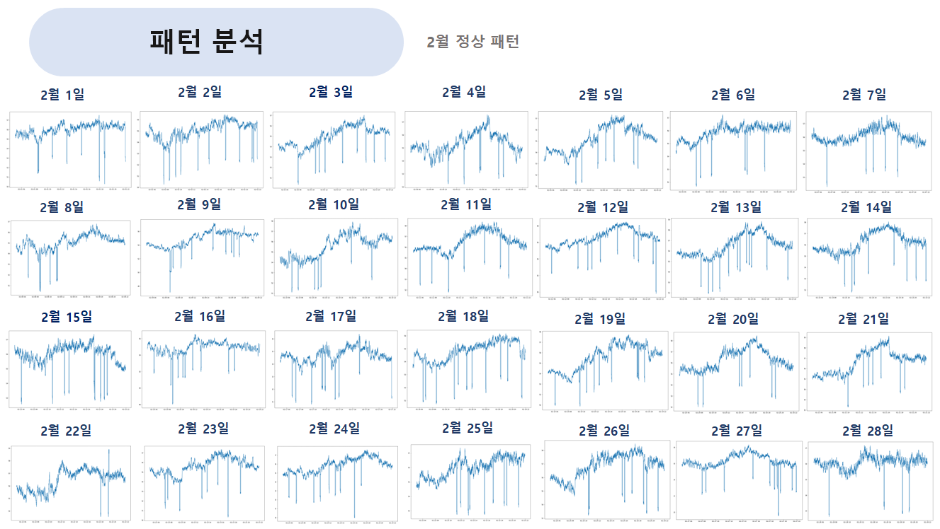
MOVING AVERAGE
- 서대전 AF DN2T 2월

Slide 46
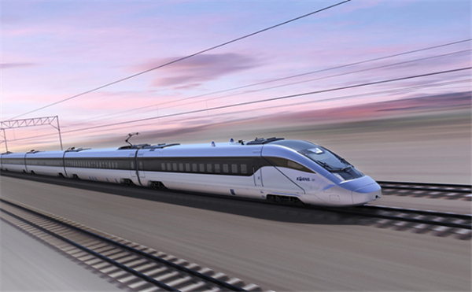
Thank You.
SEHWA
Jimin Ha
1% POSSIBILITY…REALIZE
010-9589-8817
jmha@sehwa.biz
www.sehwa.biz

